Slide 1
Air Sea Fluxes & Ocean Heat Budget
Radiative Fluxes
Turbulent Fluxes
Global heat budget
Freshwater flux
Buoyancy flux

Slide 2
Why is the Ocean in motion ?
There are three sources of energy for motion in the ocean:
Radioactive decay.
Tectonics hence earthquakes/tsunamis.
Geothermal heating: minor effect.
Gravity and kinetic energy of the Earth-moon-sun system.
Tides.
Solar Radiation.
Direct: Ocean temperature (& density).
Indirect: Winds, freshwater flux.

Slide 3
Solar Radiation & Earth's Energy Balance

Slide 4

Solar radiation
Sun is ultimate source of energy for nearly all variability in ocean and atmosphere.
Solar constant: average energy flux density from the sun perpendicular to sun’s rays.
S =1368 Wm⁻² ± 3.5% (max in Jan).

Slide 5
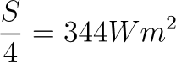
Solar radiation
Total power incident on the Earth.
Average power per unit area of Earth’s surface
-
(Area of sphere = 4πR²)

Slide 6
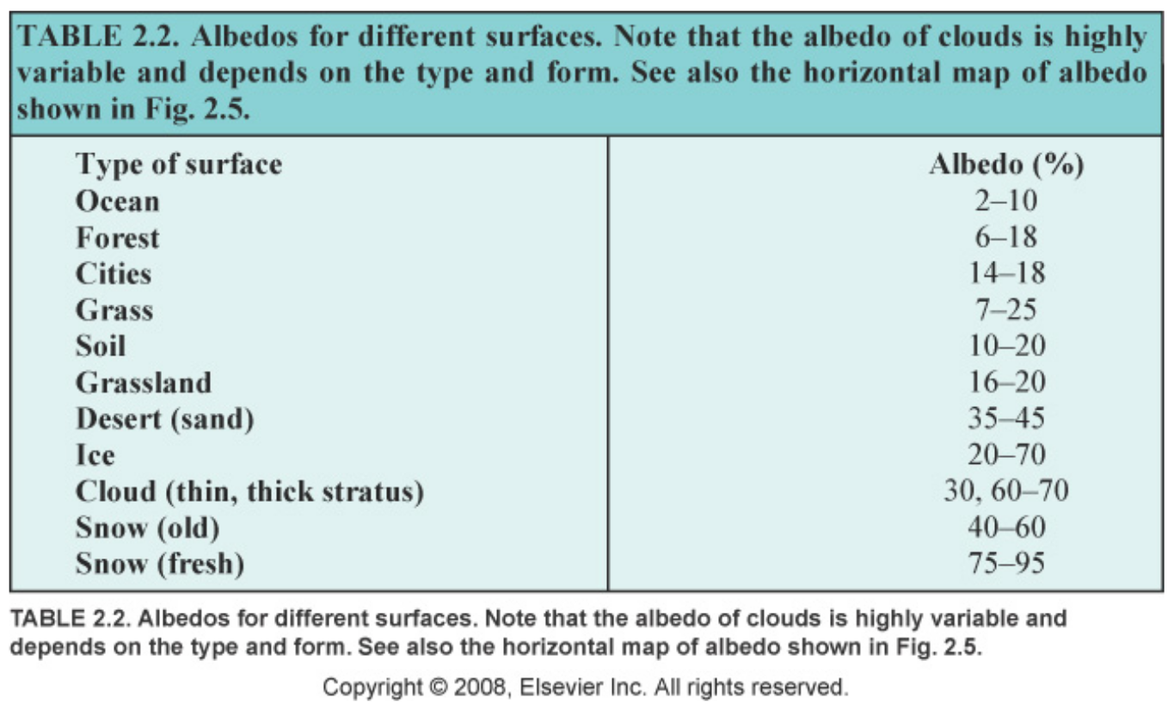
Albedo
Fraction of incoming radiation reflected or scattered.
Average value 0.3, so on average 240Wm⁻² absorbed.

Slide 7
Solid earth (no fluids)
Consider a solid planet (no atmosphere nor ocean) receiving 300 Wm⁻² at the equator.
If it is in steady state, it radiates as much energy as it receives.

Slide 8
Physics: Stefan’s Law
The total power radiated per unit area by an ideal ‘black’ body of temperature T is
E = σT⁴ Wm⁻²
σ = 5.7 × 10⁻⁸ W m⁻² K⁻⁴ (Stefan-Boltzmann constant)
The ocean and atmosphere are not black bodies, so they radiate less.

Slide 9
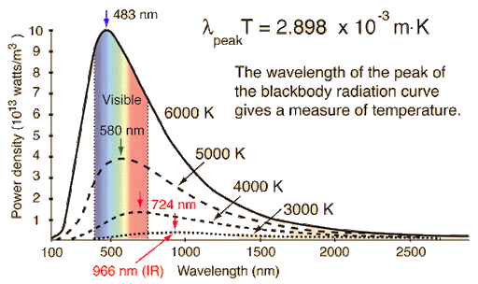
Physics: Wien's displacement law
The distribution of radiance against wavelength shifts to shorter wavelengths for increasing temperatures.
The wavelength corresponding to the peak radiance is given by
λT = 2898 µm.K

Slide 10
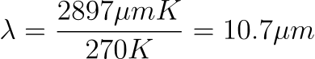
Solid earth (no fluids)
Consider a solid planet (no atmosphere nor ocean) receiving 300 Wm⁻² at the equator.
If it is in steady state, it radiates as much energy as it receives.
Stefan’s law gives us the black body temperature needed:
σT⁴ = 300 W m⁻²
⇒ T = 270◦ K (−3◦ C)
(If we did this at the poles, T would be less than -100ºC)
Peak of radiation distribution is given by Wien’s law is:

Slide 11
Greenhouse effect
Think of the atmosphere as a sheet of glass that all of the Sun’s energy go through.
A fraction of our glass atmosphere (call it e) perfectly absorbs and radiates long wave radiation (LWR). The remaining (1- e) is transparent to LWR.
Where our glass atmosphere radiates, it obeys Stefan’s law.

Slide 12
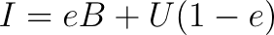
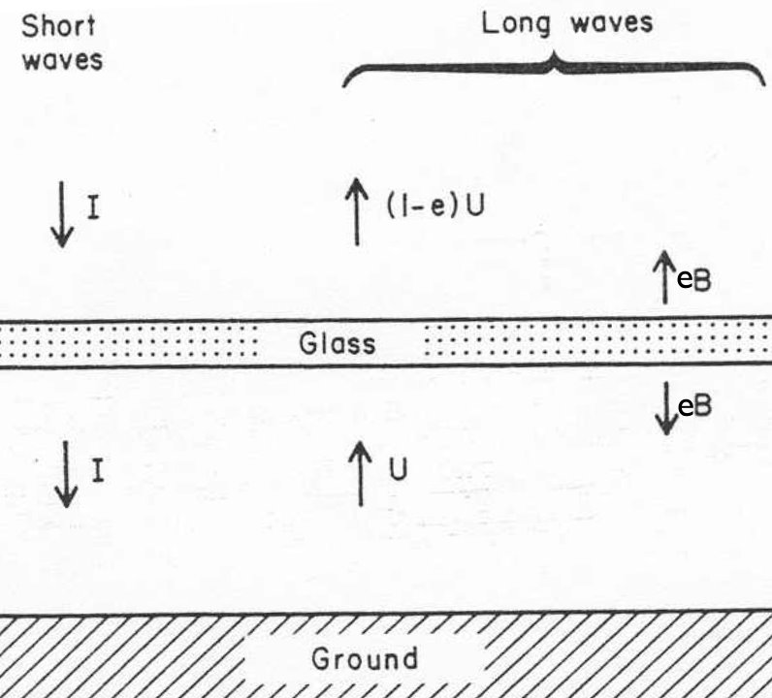
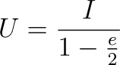
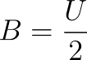
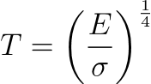
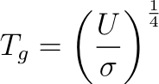
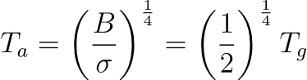
Greenhouse effect
I and e are known.
Temperature of the ground and atmosphere are
With I = 300 Wm⁻² and
e = 1, T_{g} = 320ºK (47ºC) at equator
e = 1/2, T_{g} = 289ºK (16ºC) at equator

Slide 13
The Ocean's Heat Budget & Surface Fluxes

Slide 14
Role of ocean in Global Heat Budget
A most important component
Covers 71% of the surface of the earth
Ocean has a low albedo (except sea ice)
Very high heat capacity
Ocean contains 1000 times more heat than the atmosphere, and about 100 times than the land.
Seasonal processes:
Water column mixing
Heat storage

Slide 15
Role of ocean in Global Heat Budget
Heat Capacity:
Ocean: 4000 J/kg
Lithosphere (rock and soil): 800 J/kg
Atmosphere: 1000 J/kg
Exchange Volume: exchanging heat seasonally
Ocean: upper 10 – 100 m
Lithosphere: 1 - 2 m
Troposphere: 10 km

Slide 16
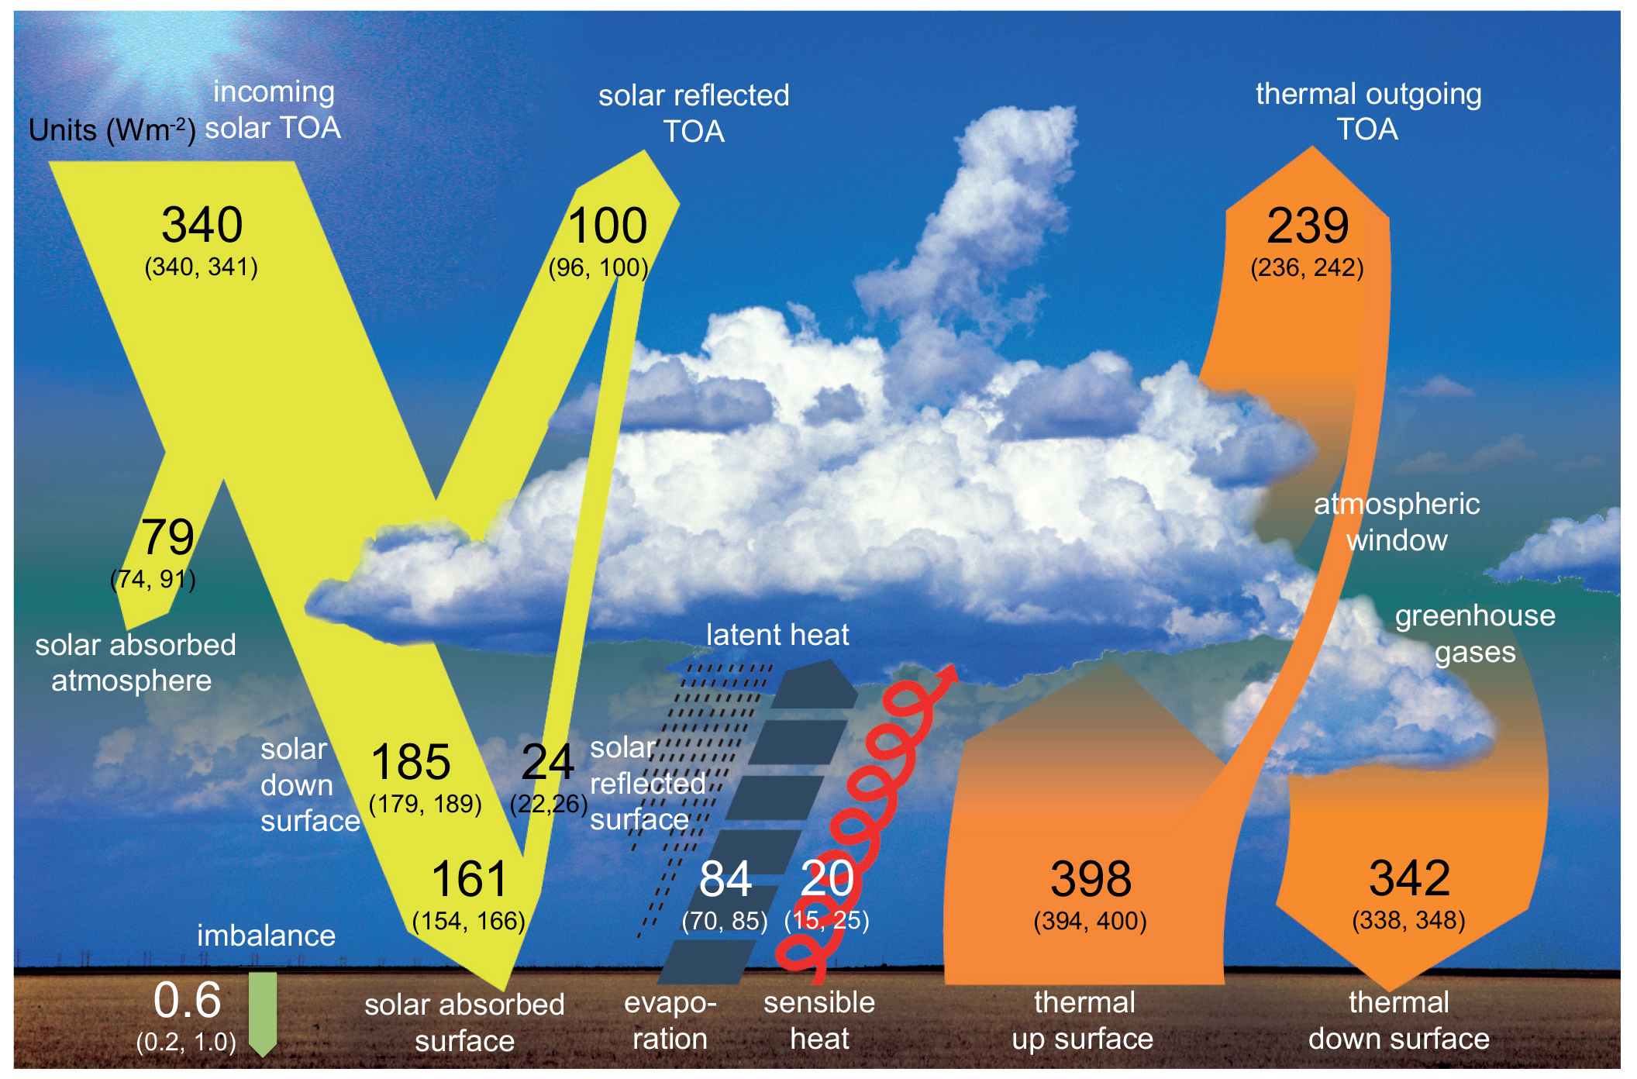
Global Heat Budget
IPCC,AR5

Slide 17
Review of term “Flux”
A flux is the rate of transport of something across a specified area.
Flux density is the transport of something across a unit area.
Mechanisms of flux:
Radiative; Heat only.
Advective; physical movement by the fluid.
Diffusive; molecular or eddy diffusion.

Slide 18
Conservation of heat energy in the global ocean
Oceanic heat sources / sinks (from Stewart)
Solar radiation: Qsw (+)
Long wave radiation: Qlw (-)
Conductive (sensible) heat Qs (-)
Latent heat loss Ql (-)
Advective heat loss/gain Qv (+/-)
Qt = Qsw + Qlw + Qs + Ql + Qv
Over short time scales, global ocean heat budget is roughly in steady state (dQt / dt = 0)
dQt/dt = 0 = Qsw + Qlw + Qs + Ql + Qv

Slide 19
Ocean Heat Fluxes Approximate Magnitudes (Watts / m2) (mean over 24 hours)
Qsw - solar radiation +150 (annual range 80 to 200)
Ql - evaporation / condensation – latent heat - 90 (annual range -50 to -160)
Qlw – long wave radiation - 50 (small annual range)
Qs – conduction -10 (annual range +5 to -40)
Qv – advective heat
NOTE: What should Qv be when averaged over entire ocean?

Slide 20
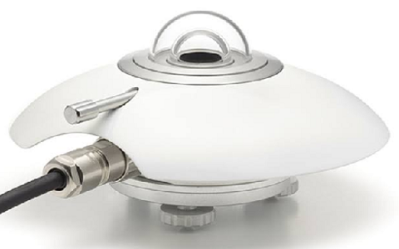
Short Wave Radiation (Q _{SW})
Incoming shortwave radiation always add heat.
Influencing Factors :
Day length
Solar elevation (angle)
Scattering
Atmospheric absorption
Simple parameterization:
Q_{I} = Q_{I0} (1 − α_{s} )(1 − 0.7n_{c} )
Q_{I0} is incoming radiation under cloudless conditions, a function of sun’s position.
n_{c} fraction of sky covered by cloud (daytime only).
α_{s} is surface albedo. Depends on angle of incidence, amount of skylight (vs direct light), and ocean surface texture.
Pyranometer

Slide 21
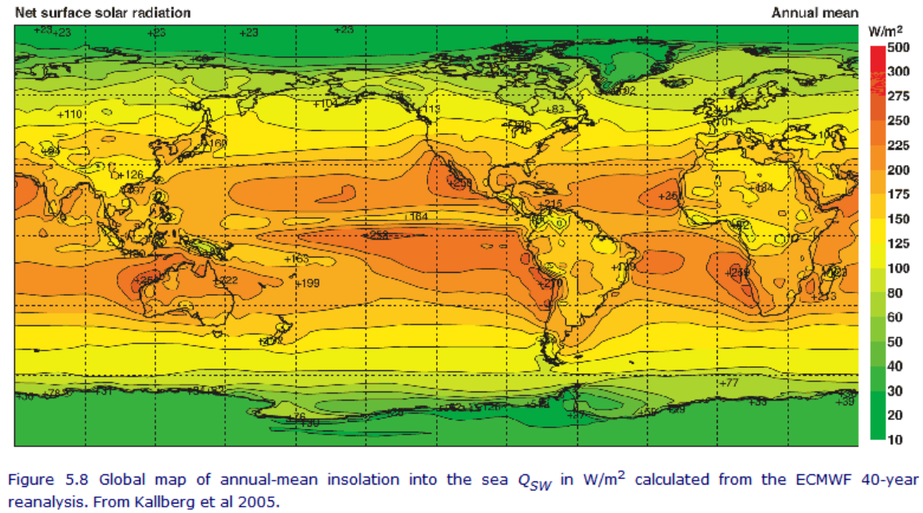
Geographic Distribution of Solar Radiation at Surface (Qsw)

Slide 22
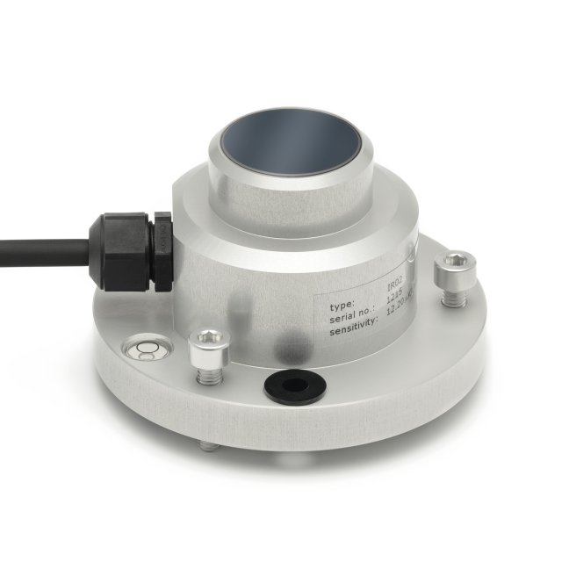
Long Wave Radiation (Q_{LW})
Primarily determined by SST
Atmosphere also a source of long radiation
Long wave radiative flux depends on: temperature of ocean, atmosphere temperature and air water vapor content
Long wave flux strongly influenced by:
– Cloud cover amount and height
– Atmospheric water vapor content
pyrgeometer
e_{a} is vapor pressure of water in atmosphere at standard height. This increases rapidly with temperature (for any given relative humidity), so the net effect of increased SST is normally a decrease in loss of heat by LWR.
Q_{LW} = 0.985σT⁴ (0.39 − 0.05 (e_{a})^{1/2} )(1 − 0.6n²_{c} )

Slide 23
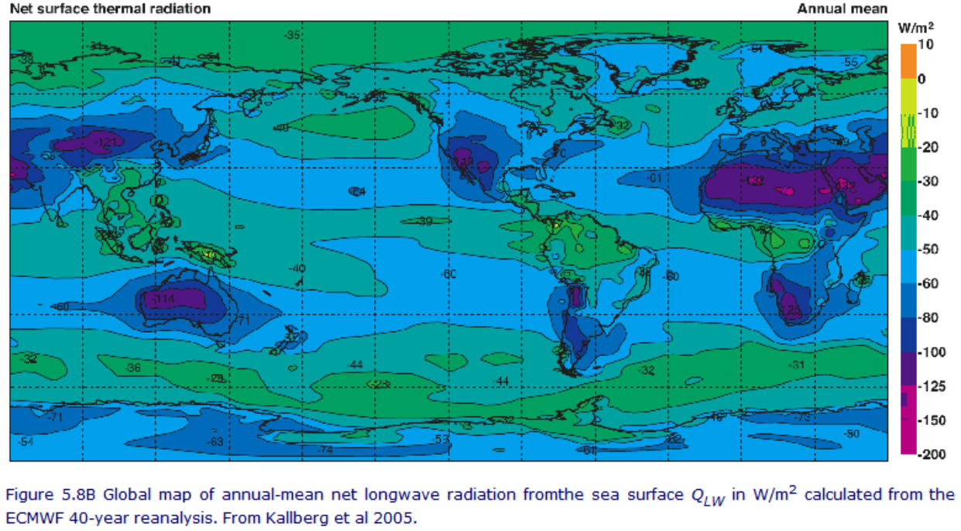
Geographic Distribution of Long Wave Radiation (Q_{LW})

Slide 24
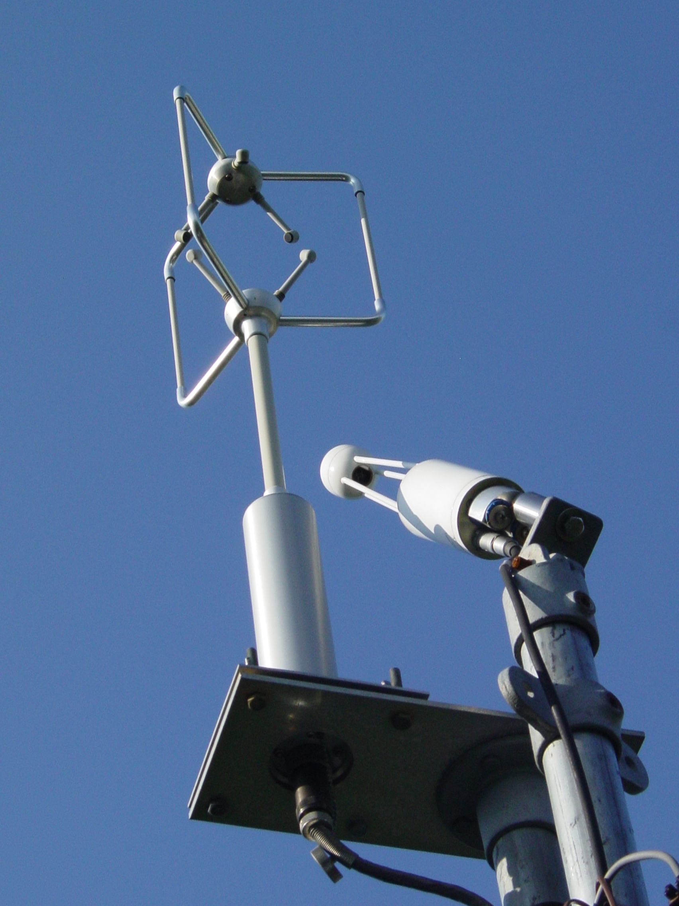
Turbulent heat fluxes (Sensible and latent)
Occur over turbulent boundary layers
Possible but difficult to measure directly
Parameterized based on readily measurable quantities, e.g., wind speed at standard height
Assume …
Wind speed → strength of turbulence
ΔT, Δq over lowest 10 m of atmosphere is representative of boundary layer
Details of the turbulent structure do not matter; only need the average gradient
Eddy covariance flux system

Slide 25
Surface latent heat flux Exchange due to evaporation
Mean volume ocean evaporation: 1.0 – 1.2 m yr –1
Rate of evaporative heat loss based on water vapor gradient and turbulence in overlying air.
E, is the mass flux of fresh water from the ocean to atmosphere
E = ρ_{a} C_{E} |U₁₀ |(q_{s} − q_{a} ) [kg m−2 s−1 ]
ρ_{a} is density of air at sea level (~1.178 kg m⁻³). C_{E} is about 1.3X10⁻³. U₁₀ is wind speed at 10 m. q_{a} is the specific humidity (mass fraction of water vapor in air) at 10 m. q_{s} is the saturation humidity at the sea surface temperature

Slide 26
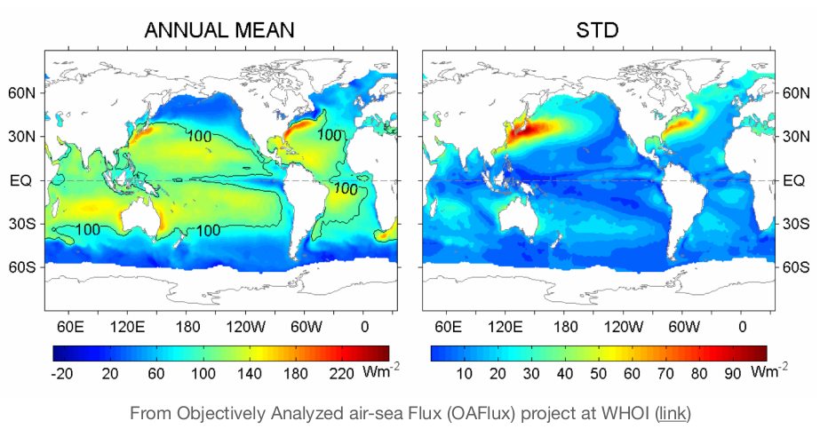
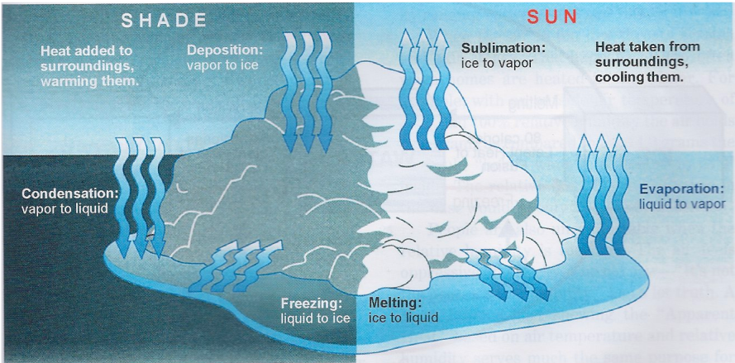
Latent heat flux (heat loss by evaporation)
QL = ρa Lv E
Lv is the latent heat of evaporation (2.5X106 J kg-1).

Slide 27
Surface sensible heat flux :
Exchange due to conduction
Qs = ρ_{a} c_{p} C_{h} |U₁₀ |(T_{s} − T_{a} )
ρ_{a} is density of air at sea level (~1.178 kg m-3).
c_{p} is specific heat of air at constant pressure
(~1000 J kg-1 K-1)
C_{h} is a heat transfer coefficient (~1X10-3)
U₁₀ is wind speed at 10 m.
T_{s} is temperature at sea surface.
T_{a} is air temperature at a height of 10 m.

Slide 28
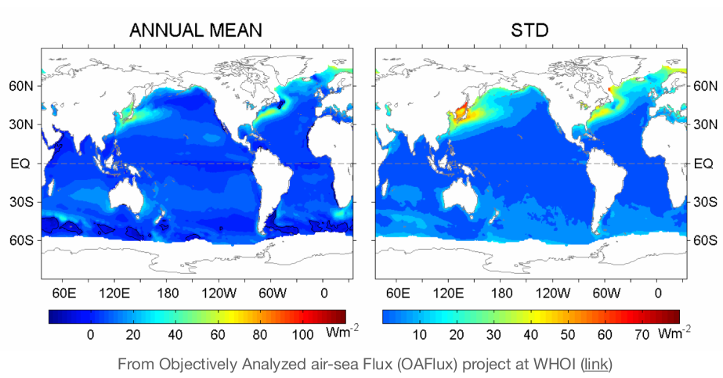
Surface sensible heat flux :
Exchange due to conduction
Over much of the ocean the sea is slightly warmer than the air.
High winds and large temperature difference cause high fluxes.
Temperature difference of 1 K and U₁₀ of 10 m s⁻¹ causes the ocean to lose ~12 W m⁻².​
Largest near western boundary in mid-latitudes.​

Slide 29
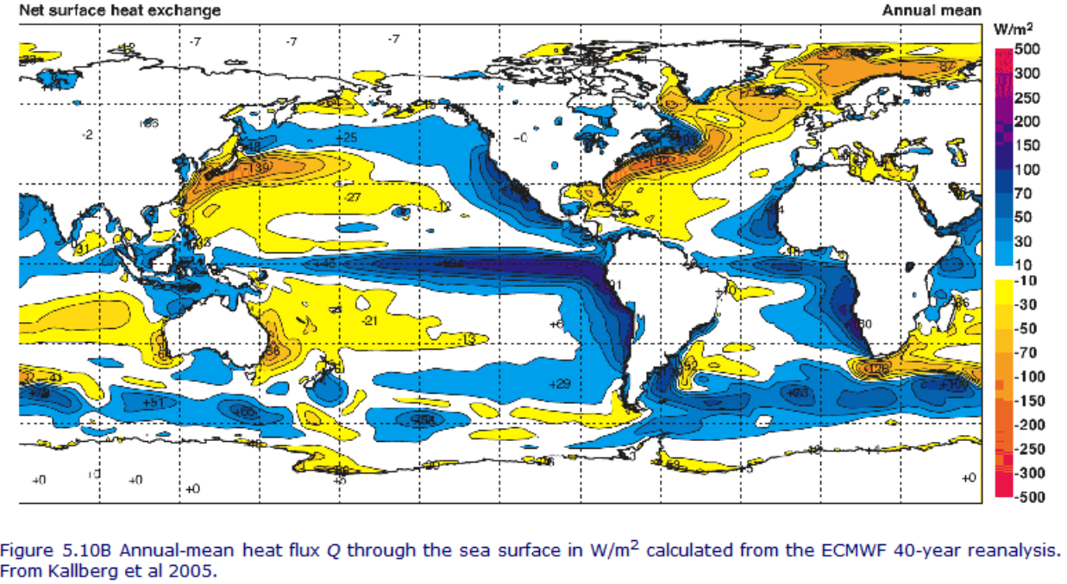
Geographic Distribution of Net Heat Flux

Slide 30
Global Implications and Broader Context

Slide 31
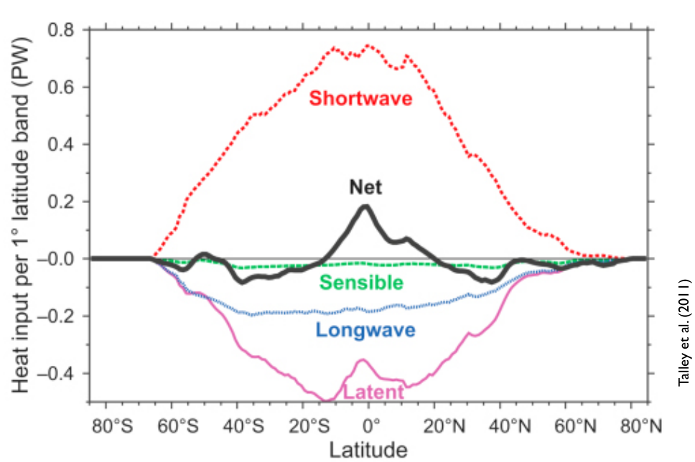
Oceanic Heat Budget
Solar important at higher latitude
Conductive and long wave fairly constant
Latent latitude dependent

Slide 32
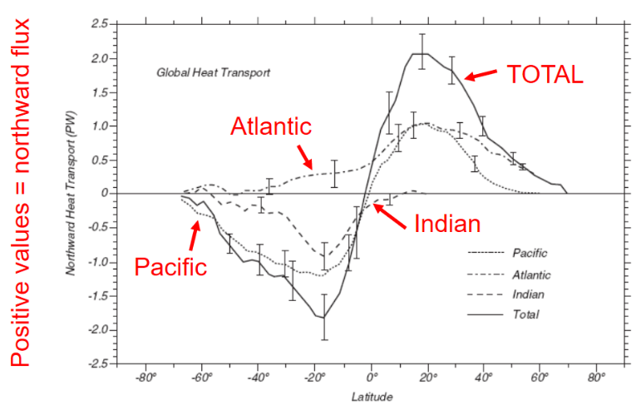
Meridional Heat Transport
The net surface heat flux cause ocean warming at lower latitudes and cooling at higher latitudes.
The currents transport heat from low latitude to higher latitudes and removes heat from the tropics and thus reduce an abnormal increase in temperature in the tropics.
Both warm currents (Gulf stream, Aghulhas, Kuroshio etc) and cold currents (Labrador, Canary etc) play a important roles in meridional heat transport.
Hence, changes in the ocean circulation will result in changes in ocean-atmosphere heat balance which can lead to change in weather patterns.

Slide 33
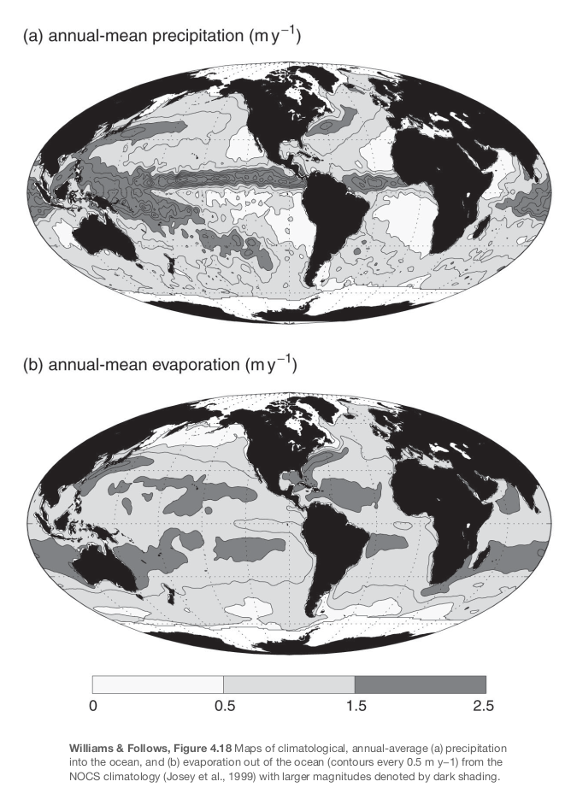
Freshwater flux
Evaporation -precipitation
P is greatest in the ITCZ and western Pacific over warm pool region.
E greatest in subtropics and western boundary regions.
E-P map looks like sea surface salinity.

Slide 34
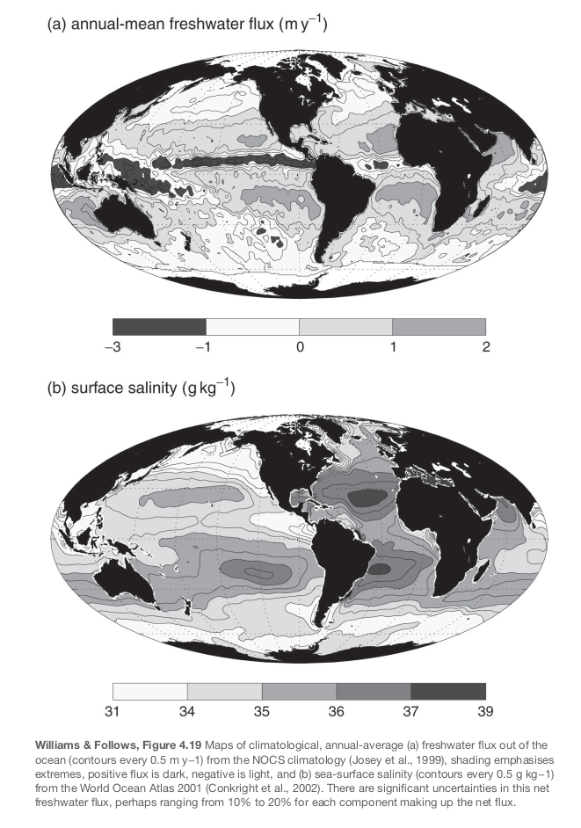
Freshwater flux
Evaporation -precipitation
P is greatest in the ITCZ and western Pacific over warm pool region.
E greatest in subtropics and western boundary regions.
E-P map looks like sea surface salinity.

Slide 35
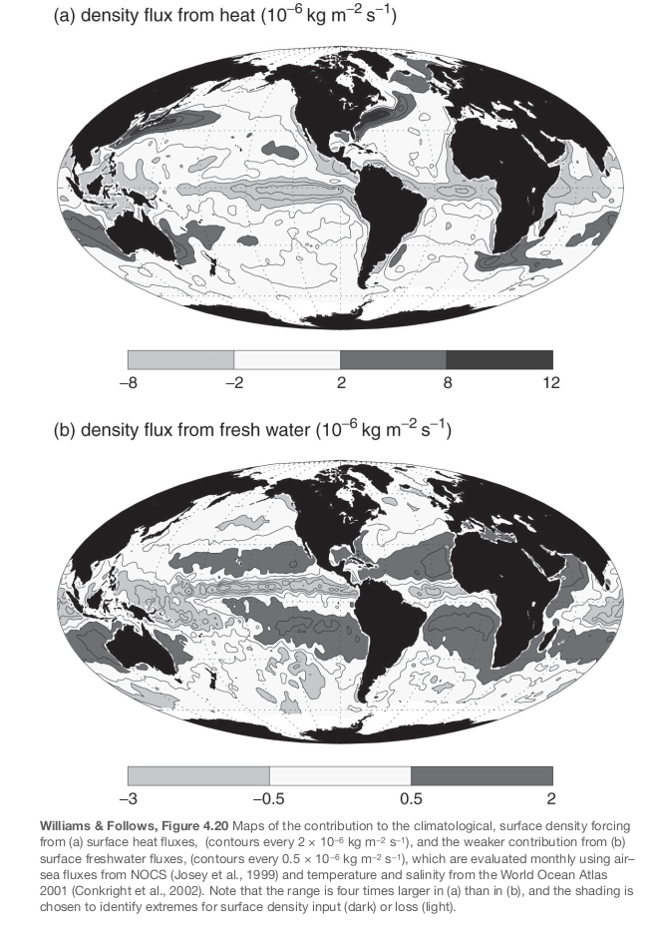
Buoyancy flux
Buoyancy out → water sinks
Heat flux about 4X more important than E-P for buoyancy.
- Salinity has a slightly larger role at high latitudes, because when water is cooler the sensitivity of density to temperature changes is smaller.
Evaporation contributes via cooling and increasing salinity.
Essential concept for understanding deep ocean circulation.

Slide 36
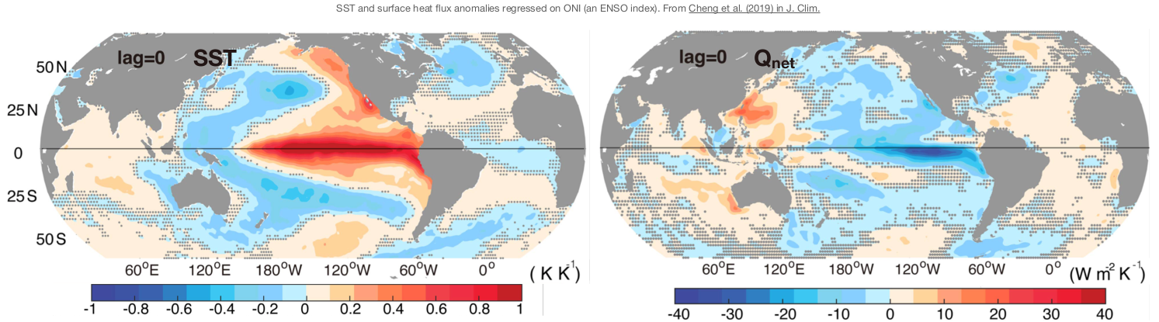
ENSO
Impact on surface heat flux
High SST in the central/eastern tropical Pacific increases latent heat flux to the atmosphere.
Convection, precipitation, and ascending branch of Walker circulation shifts to central Pacific
Leads to a reorganization of global atmospheric circulation and distant climate teleconnections.

Slide 37
Data, Measurement, and Uncertainties

Slide 38
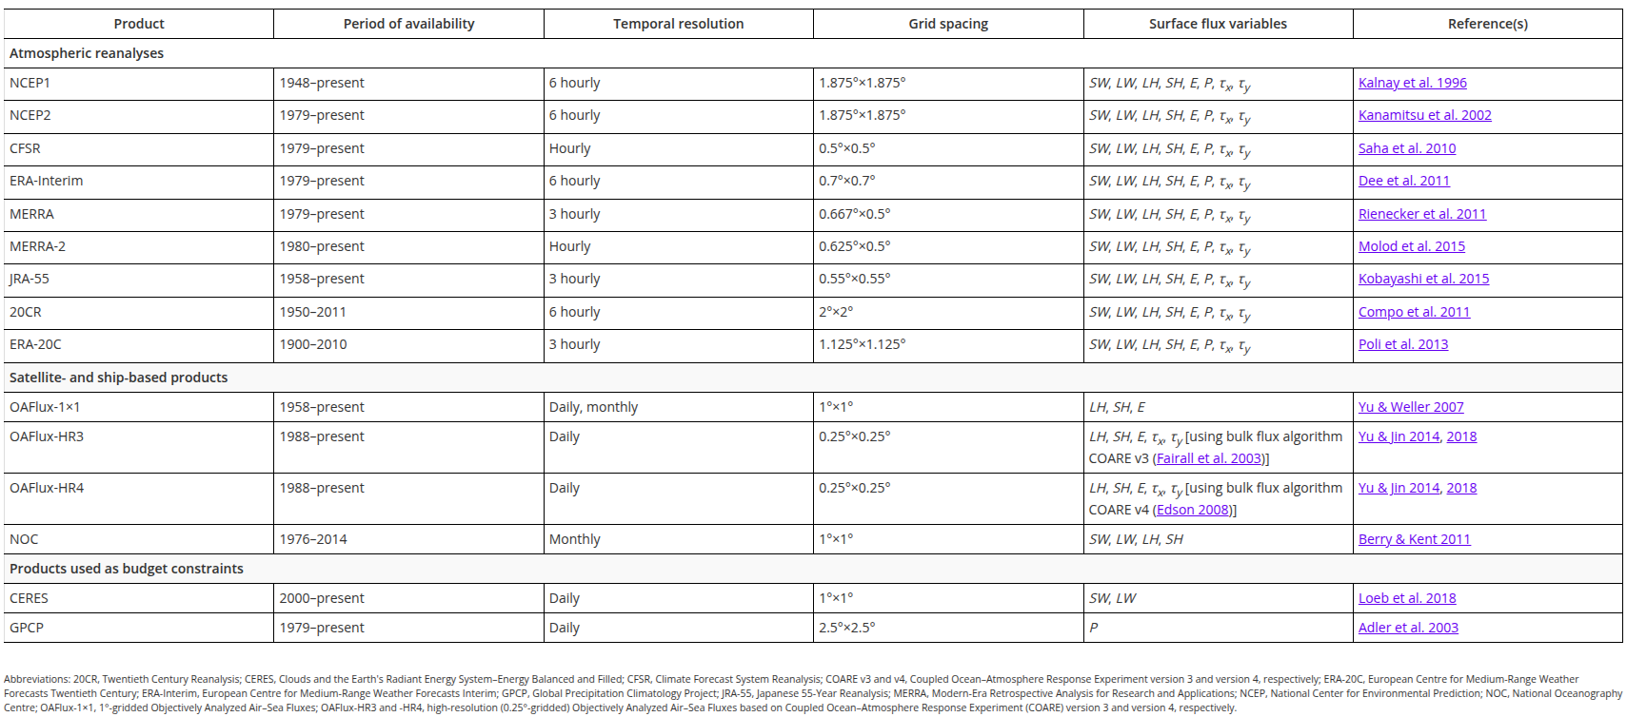
Global Air-Sea Flux products
Lisan Yu 2019

Slide 39
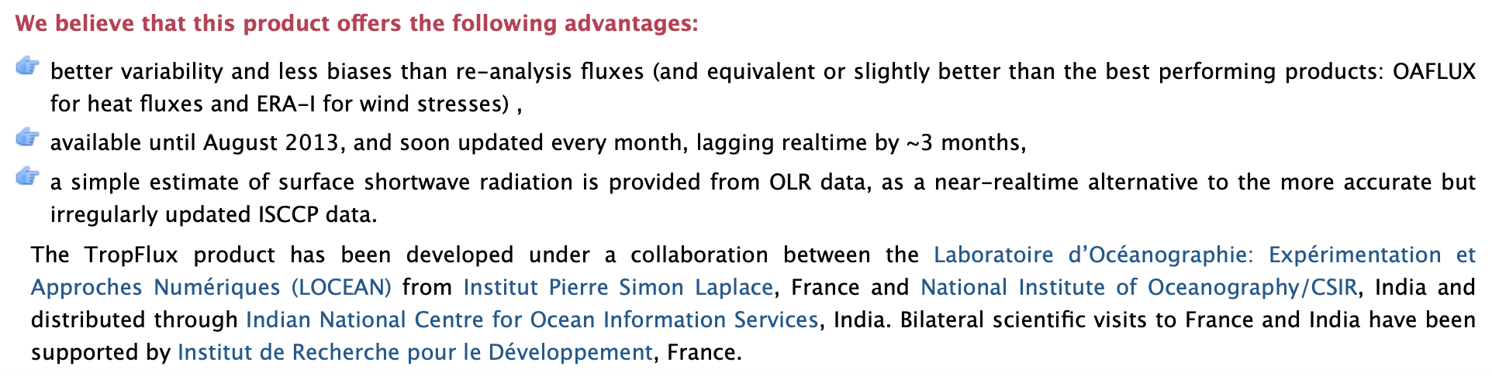
Tropflux
Praveen et al 2012
The TropFlux project aims at providing daily, timely, accurate air-sea heat and momentum flux data for the entire 30°N-30°S region.

Slide 40
Surface heat fluxes Challenges to address
From Cronin et al. (2019):
Overall difficulty of in situ measurement
Better accounting of wind ‘gustiness’
Better representation of wind-wave and wind-current interaction
Impacts of sea-spray and roughness
Inclusion of sea state in parameterization
Need wind speed relative to ocean (a source of bias since surface waters generally move in direction of wind)
Assumption that SST and specific humidity data represent ocean ‘skin’ values.
E.g., SST data are generally representative of some thin layer (centimeters to meters), not the true ocean skin temperature.
Surface temperature and humidity are difficult to accurately extract from satellite measurements
• Difficult to resolve atmospheric boundary
Layer
• And more …

Slide 41
Heat budget Closure
Over sufficiently long timescale, the net heat flux into the ocean must average to close to zero otherwise there would be significant warming or cooling trends.
But, calculation of net heat flux may not lead to zero, that shows the error in heat flux estimates. To make a balance, the heat budget should be closed by making adjustments.
A global mean net heat gain of 1 Wm−2 for the period of one year would, if mixed into the upper 1000 m of the ocean, lead to a mean temperature increase in that layer of 0.10 C .
Climatological global mean heat budget must be closed to within 2–3 Wm−2 .
The problem arises from fundamental biases in the bulk formula estimates. For example, under sampling in regions of strong air-sea interaction.
Closure can be achieved by making adjustments locally or globally. Usually, global adjustments are done.

Slide 42
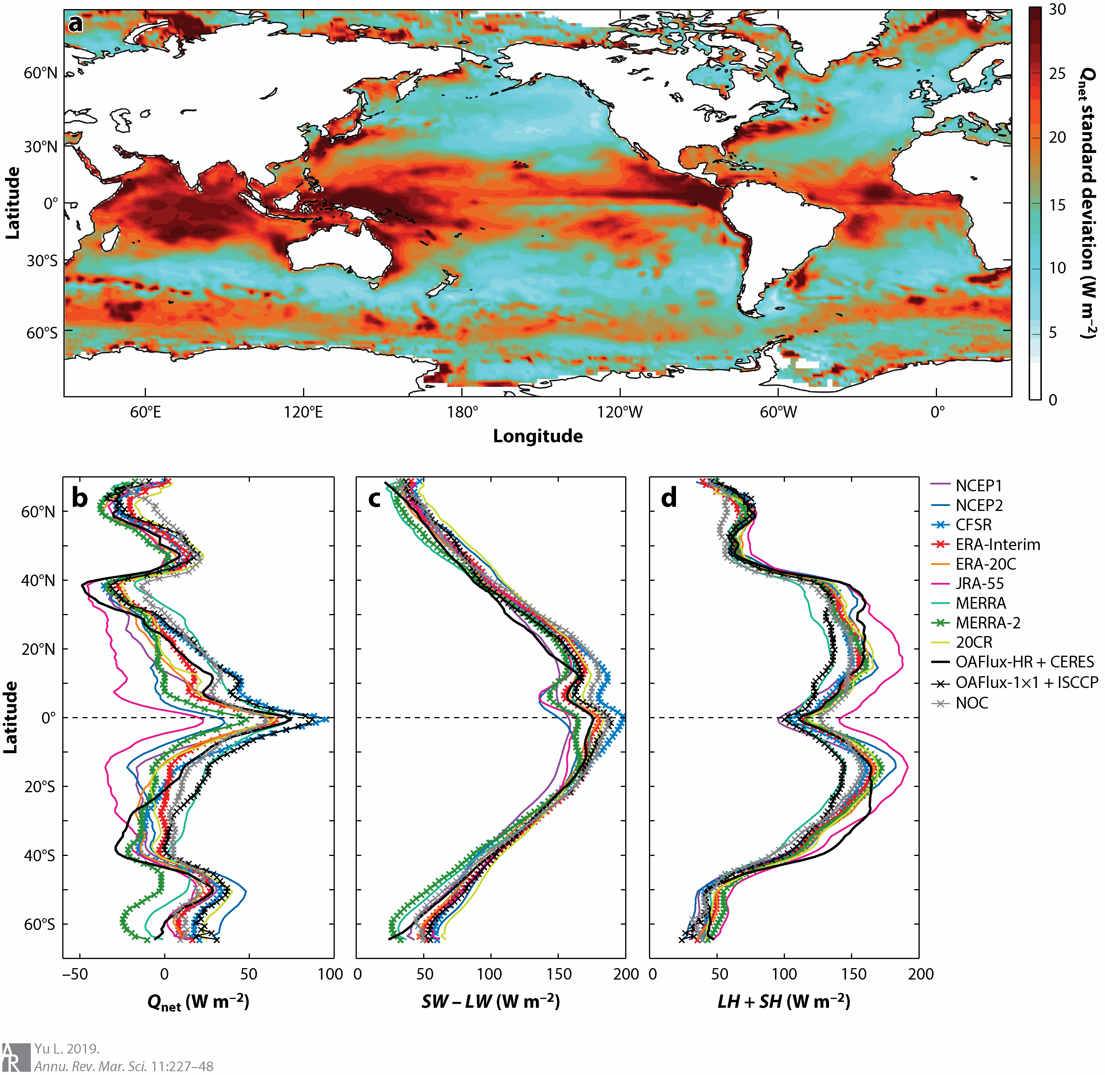
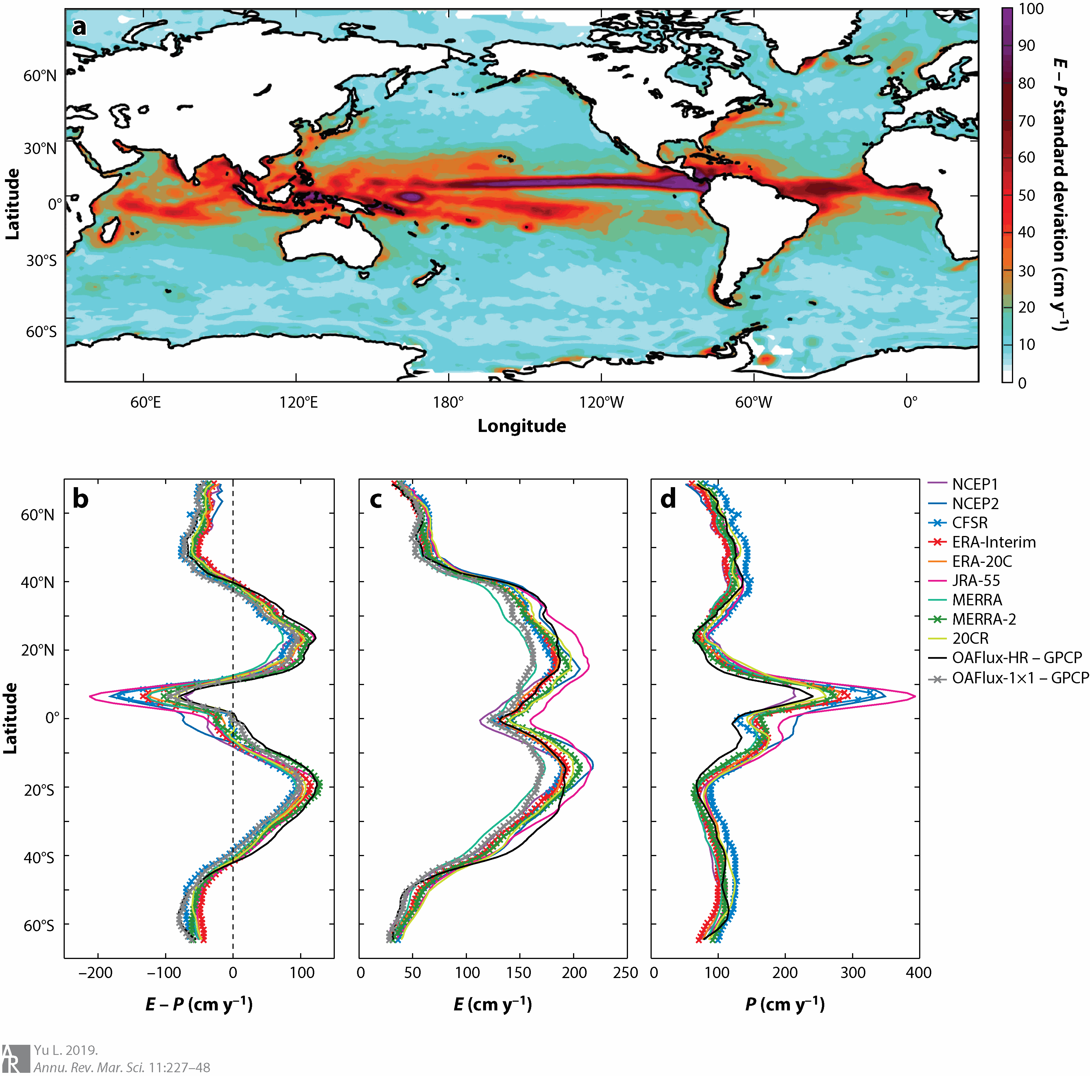
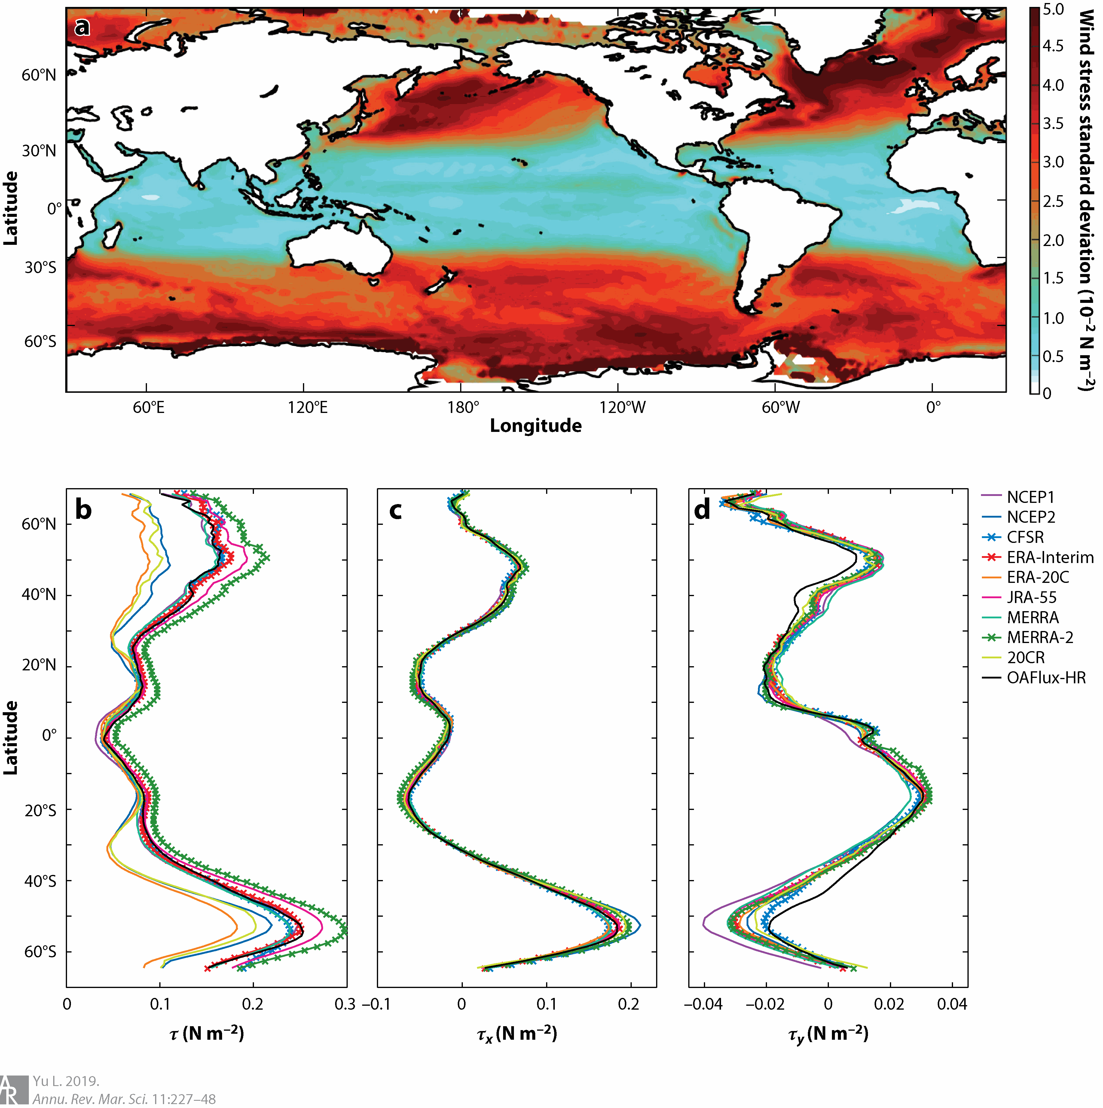
Surface fluxes Variability over products
Q _{net} products.
E − P products
10 mean wind stress magnitude

